Slide 1
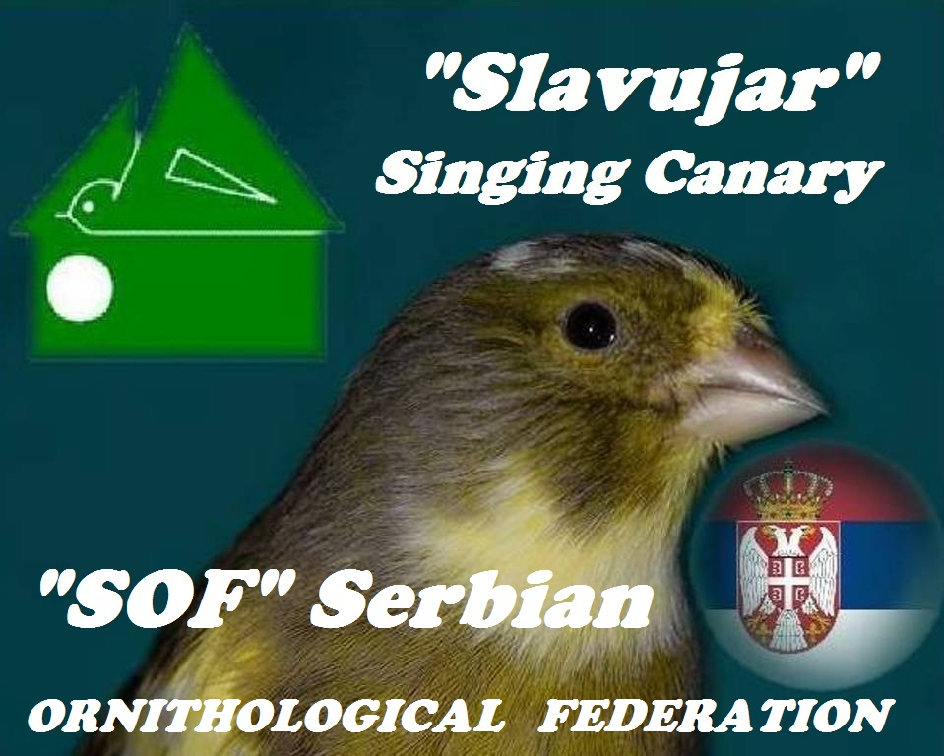

Slide 2
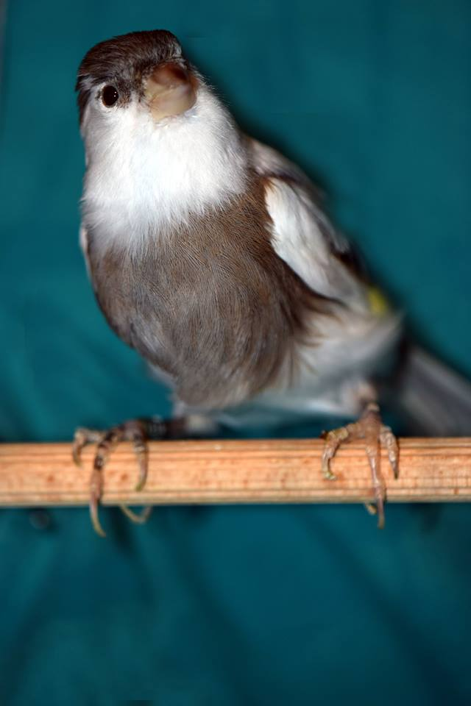
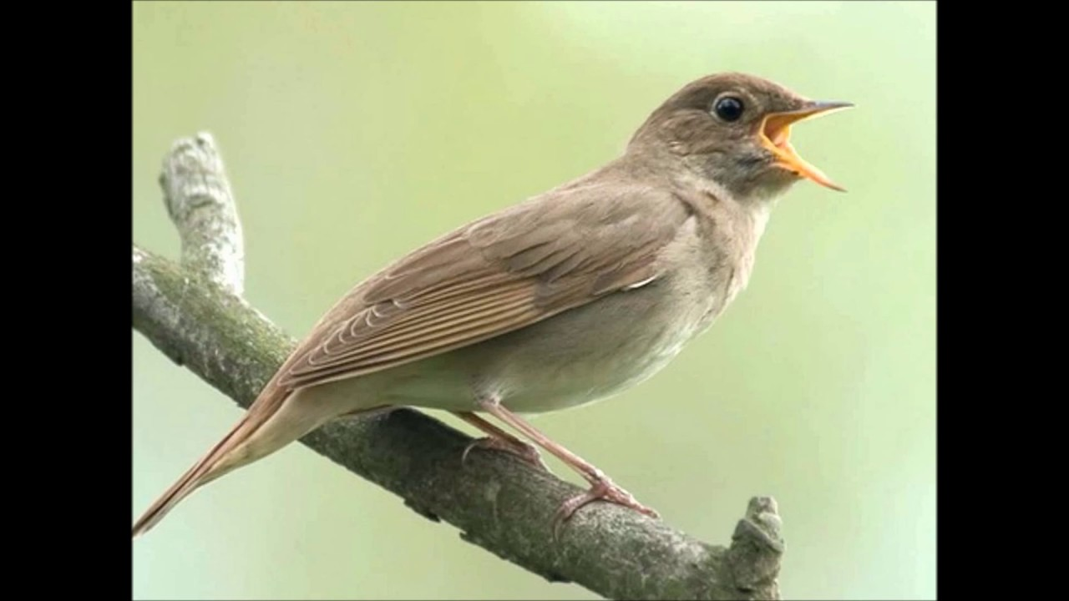
Song Canary "Slavujar"
In the middle of the twentieth century, Canary breeders in Serbia began to train their birds the song of nightingale (Luscinia megarhynchos).
Since the song is very varied, only a few Canaries were able to learn this wonderful song, so the selection was very strict (rigorous).

Slide 3
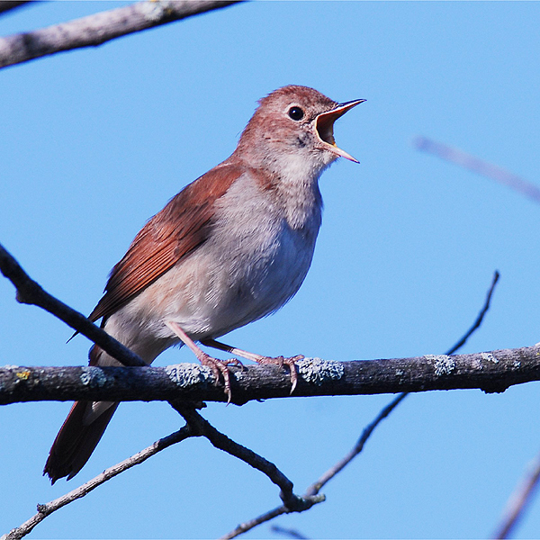
Song Canary "Slavujar"
Technology at that time was not developed as today, so the breeders trained their birds in various ways and the best results were achieved with tape recorders.

Slide 4
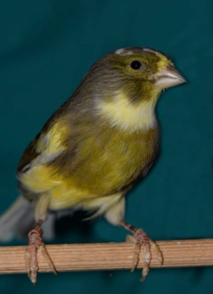
Song Canary "Slavujar"
Thanks to the invested work and the selection of the bird, they are rich in a large number of melodies that mostly originate from the song of slavujar. Through decades of work both on the selection of the birds themselves and the selection of the most elit specimens, the breeders have also been working on the selection and customization of melodies from the Slavujar song that is acceptable to the canaries of Slavujars. That's why, we have, today, a slavujar who sings up to 30 sequences (tours) (melodies).

Slide 5
Song Canary "Slavujar"
After nearly three decades of creating the race, the first competitions began in the mid-eighties. In the interest of better and faster creating a specimens of this new race, a organization was founded of the "song canaries", Serbian singer-Slavujar, at the Alliance of organizations for the protection and education of birds of Yugoslavia on June 24, 2000. The rules and standards for competitions were soon established as well as the conditions: the form of competition cages, the way sequence (tours) are evaluated and everything else that is necessary for the competitions to be held.

Slide 6
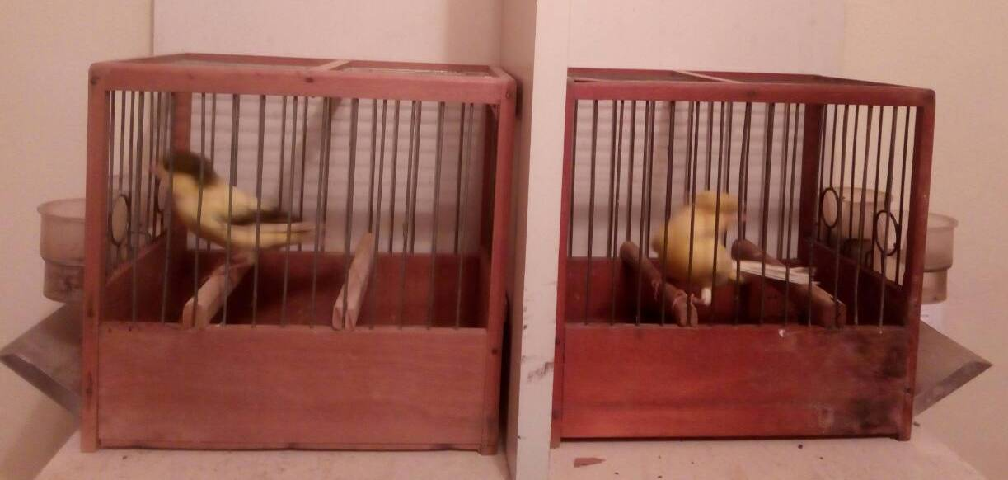
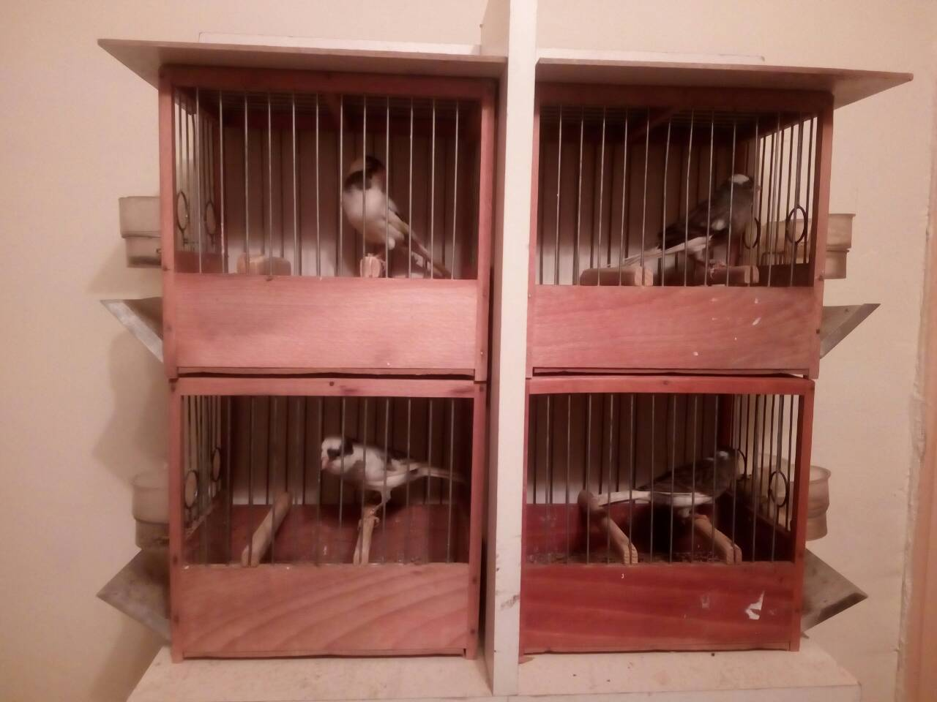
Song Canary "Slavujar"
There are 6 categories in the competition, as individually singing, in pairs and a collection of 4 birds, separately for young and for old birds.
Individually – Individuel
Couples – Serie de 2
a collection
of 4 birds -
Stam 4

Slide 7
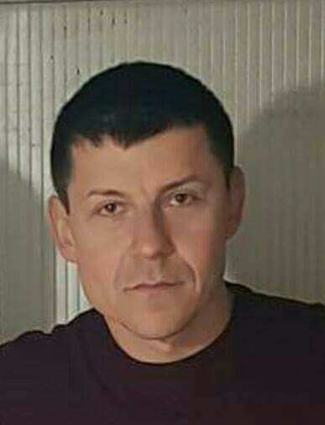
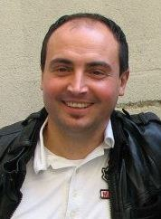
Song Canary "Slavujar"
At the state championship, Slavujari appeared for the first time in 2001 in a special category that our organization called Section "S“.
2003 after passing the judge examination Branislav Karajović, Milovan Stojadinović, Životije Arandjelović in 2017 Radmilo Disivojević and
2018 Aleksandar Kostadinović become official judges for Slavujar.

Slide 8
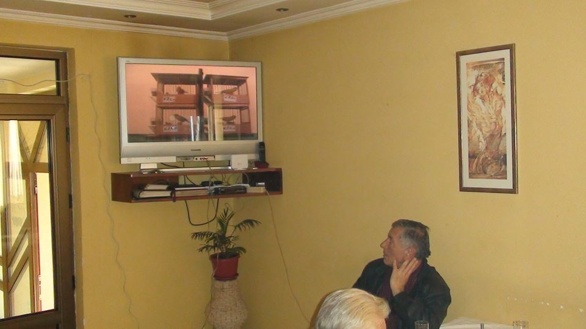
Song Canary "Slavujar"
In Serbia, 5-6 competitions are held each year. Competitors through video connection can follow the evaluation process itself, which is also a great reason for socializing and exchanging experience among breeders.
In 2005, the first competitions in the Republic of Macedonia were organized, and in 2011, breeders from Romania were involved, so Slavujars are becoming more and more popular throughout the region. So today, besides the mentioned countries, we have them in Bulgaria, Bosnia and Herzegovina , Kosovo and Albanija.
Since the joining of the AOR in 2011, international competitions, called Balkan Championships, began to be organized, so there were some competitions in Romania, Serbia and Macedonia.

Slide 9
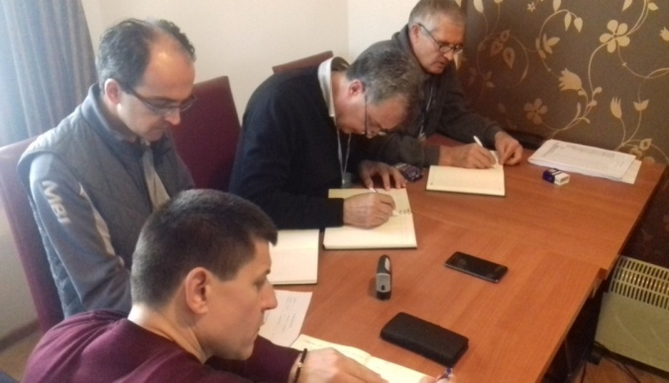
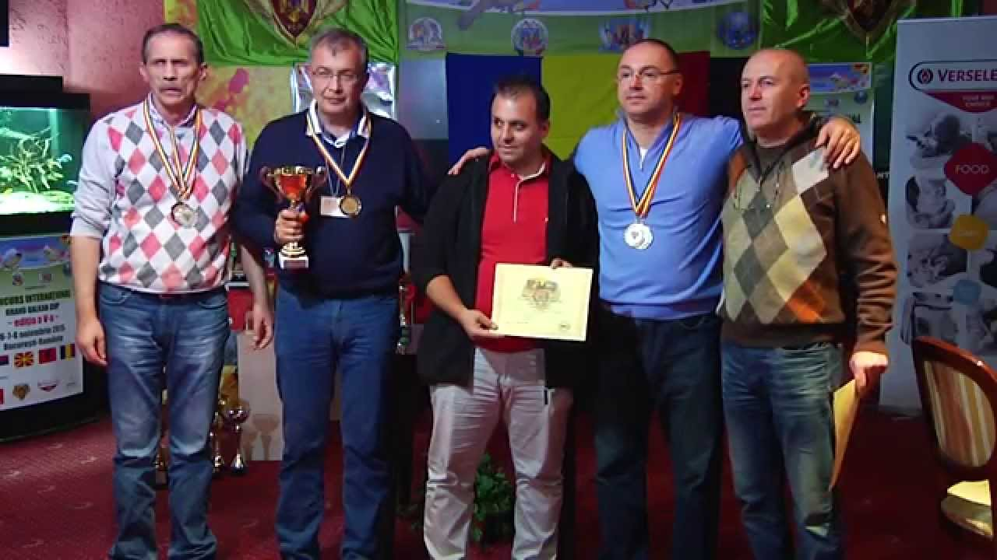
Song Canary "Slavujar"
After the negotiations between the AOR, OFM and SOF in the coordination of OMJ and COM , 2017 can certainly be called as crucial on the path of recognizing the new race of the Song Canary "Slavujar".

Slide 10
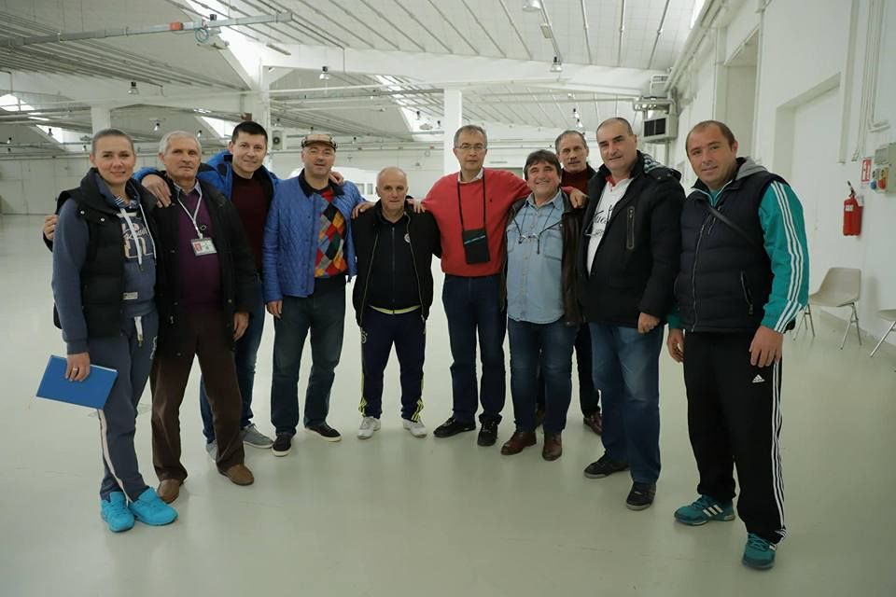
Song Canary "Slavujar"
The crown of these events is certainly the Balkan Cup in Cesena held from 08-12.11.2017, hosted by the President of OMJ, Roberto Rossi, and participants from Romania, Macedonia and Serbia. In addition to the competition, important decisions were made for further cooperation, among which the most important, the acceptance of the Standard, the assessment list and other technical conditions for further work on the recognition of this new race.

Slide 11
Song Canary "Slavujar"
In the end, a memorandum is signed that obliges all parties for further cooperation and is also the basis for the recognition of the new race Song Canary "Slavujar".
Thank you for your attention SERBIAN ORNITHOLOGICAL FEDERATION

